Slide 1

Analyzing U.s. medical insurance costs
By: Ahmad Ammash

Slide 2
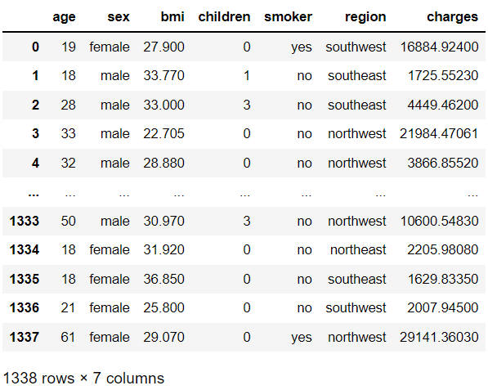
Looking over the dataset
The insurance.csv dataset contains 1338 rows and 7 columns of data with no missing/null values.
The dataset shows the cost of insurance for 1338 people based on several criteria including their age, sex, BMI, number of children and whether they smoke or not. Lastly, the region from which those individuals come is taken into consideration.

Slide 3
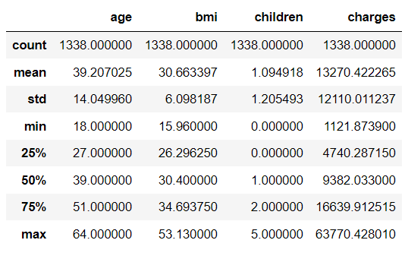
A description of the dataset
The description on the left gives a statistical summary of each of the dataset’s columns. Some figures to highlight are the average age of 39.2 years and BMI of 30.6, the maximum BMI of 53.13 as well as the huge gap between the maximum and minimum charges.

Slide 4
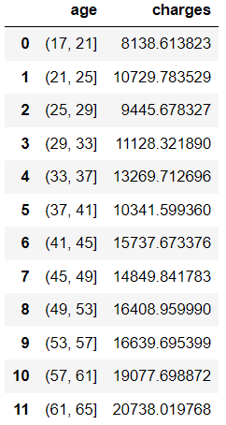
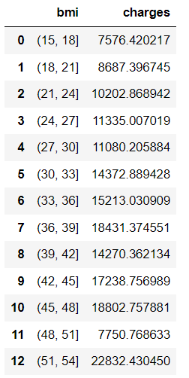
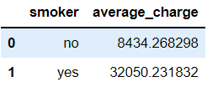
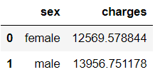
effect of predictor variables on insurance cost (ceteris Paribus)
Holding other factors constant, we can see that:
The insurance cost generally increases with age except for two age ranges (will be investigated).
The insurance cost increases with BMI except for some BMI ranges (will be investigated).
Males are charged more than females.
Smokers are charged 380% more than non-smokers.

Slide 5
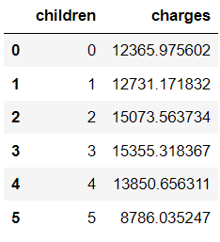
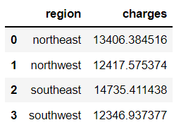

effect of predictor variables on insurance cost (ceteris Paribus)
Holding other factors constant, we can see that:
Insurance cost will remain directly proportional to the number of children up until the latter exceeds 3. Families with 4 or more children will start to witness drops in their insurance costs.
The northwest and southwest regions have an insurance cost below the average across all regions. The southeast region average cost is the highest (11.4% above average).

Slide 6
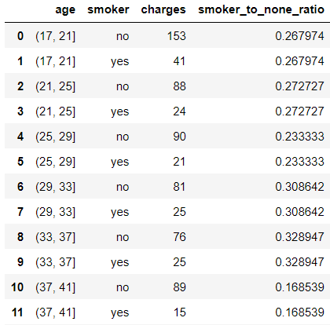
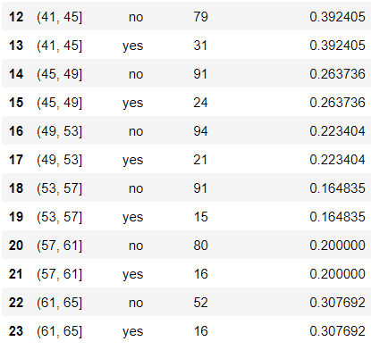
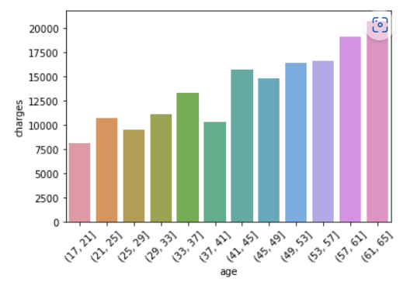
Age-smoker effect on charges
The general trend is that insurance costs increase with age.
However, we can see that the age bins 33-37 and 41-45 have a higher smoker proportion compared to the age ranges directly below or above them. This explains why we saw the spikes in the charges by age bins.

Slide 7
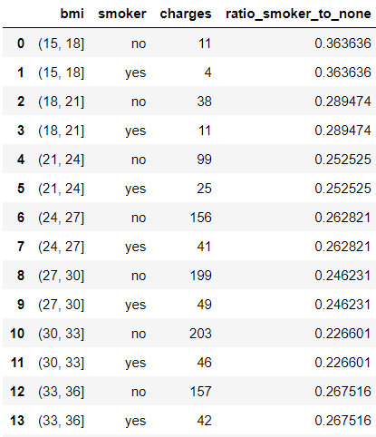
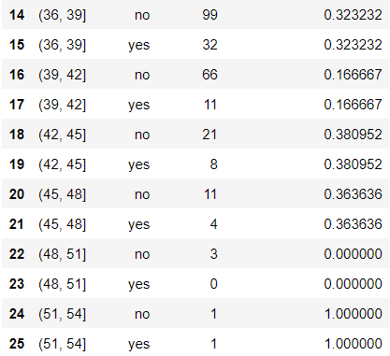
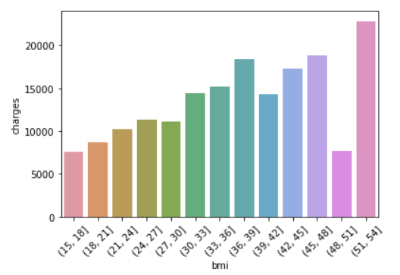
BMI-smoker effect on charges
The general trend is that insurance costs increase with BMI. However, we can see that the BMI ranges of 36-39, 42-45 and 45-48 have the highest smoker proportions (above 0.3). This fact explains why we have spikes in insurance costs at these BMI ranges. Also, the 48-51 BMI range only consists of 3 people and none of them are smokers; which is why the insurance cost is so low for them. Finally, the 51-54 range only has 2 people; 1 of which is a smoker so it’s a low-quality sample.

Slide 8
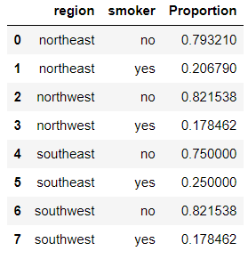
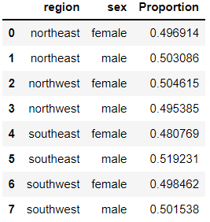
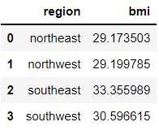
Analysis of the southeast region
25% of the people in the southeast region are smokers. The smoker proportion in the southeast is the highest of all four regions.
51.9% of the people in the southeast region are males. The male proportion in the southeast is the highest of all four regions.
The southeast region has the highest average BMI of 33.34.

Slide 9
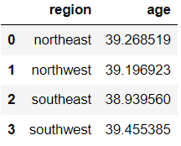
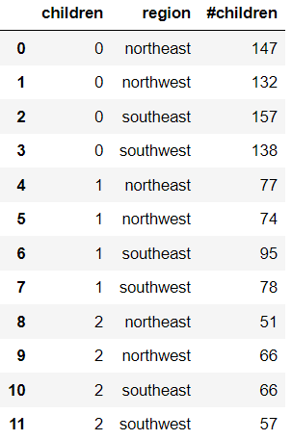
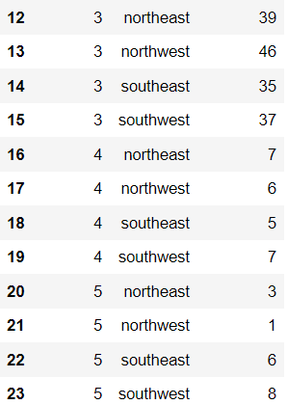
Analysis of the southeast region
The average age across the four regions is almost the same.
The southeast region has the highest number of families with 0-2 children (inclusive).

Slide 10
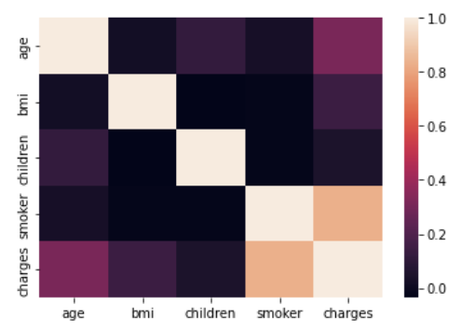
Correlation heatmap – southeastern region
The correlation heatmap shows that the highest correlations are between (in descending order):
Charges and smoker
Charges and age
Charges and BMI

Slide 11
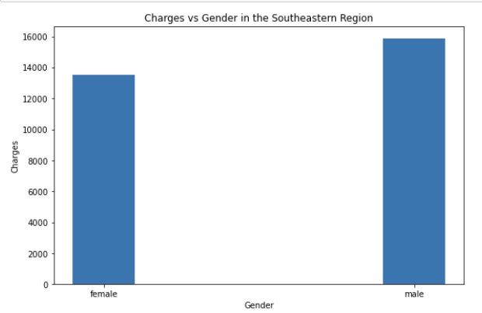
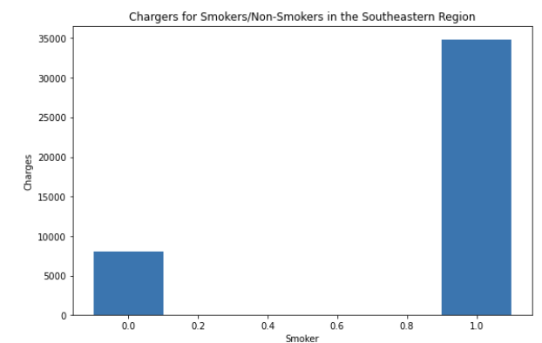
Visualizing predictor variable effects on charges in the southeast region
Based on the analysis of the southern region, we can justify the following:
The higher average cost of insurance for males compared to females and the higher proportion of males in the southeast raises the region’s overall average cost.
The incredibly high cost of insurance for smokers and the high proportion of smokers in the southeast raises the region’s overall average cost.

Slide 12
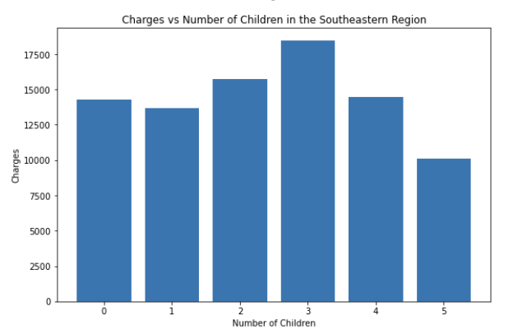
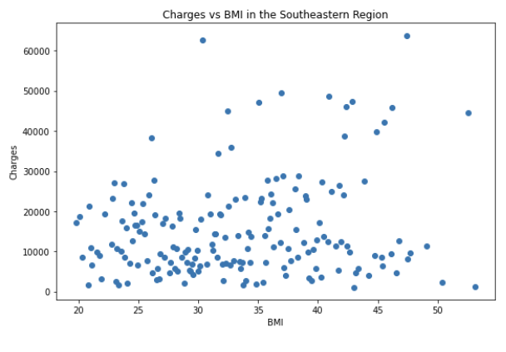
Visualizing predictor variable effects on charges in the southeast region
Based on the analysis of the southern region, we can justify the following:
The high average cost of insurance for families with 0-2 children and the high number of those families in the southeast explains the region’s high overall charges.
The increasing average cost of insurance for people with a higher BMI and the high average BMI in the southeast explains the region’s high overall charges.

Slide 13



Statistical significance testing
The p-values obtained from the statistical significance test reiterate the assumption that age has a relatively strong positive correlation with charges and a significant effect on it. Similarly, increases in BMI have a significant effect on charges and lead to an increase in them. However, the p-value of 0.54 for the #children-charges test proves that the relationship is not directly proportional. The peak of the charges is at a number of children equal to 3.

Slide 14
Conclusion #1
Conclusion #2
Conclusion #5
Medical insurance cost increases with age and BMI. Smokers and males are charged more as well.
The southeast region average charge is 11.4% higher than the overall age across all 4 regions.
There strongest positive correlation is between charges and the predictor variables is with smoker followed by age and BMI.
The southeast’s high proportion of smokers, most frequent number of children per family, gender distribution and high average BMI all justify why the southeast region has the most expensive insurance.
Conclusion #3
Conclusion #4
Insurance cost increases with number of children per family for 0-3 children. For 4+ children, the cost starts to drop.
The southeast region has the highest proportion of smokers, the most families with 0-3 children and the highest average BMI. The proportion of males in the southeast region is also the highest. The age distribution is similar to other regions.

